Slide 1
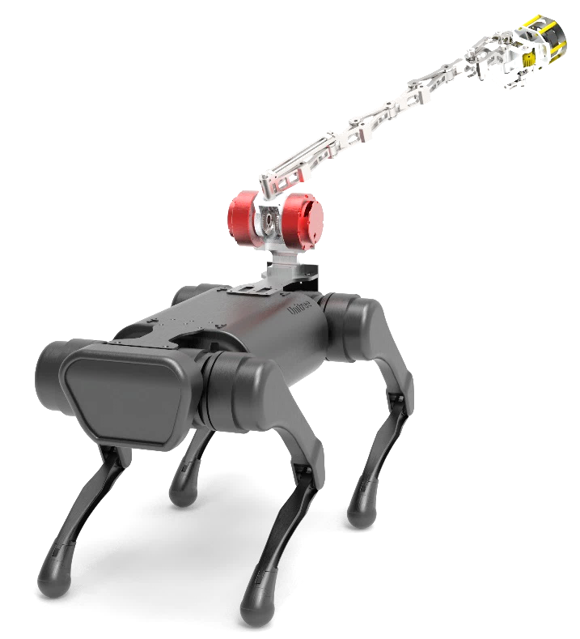
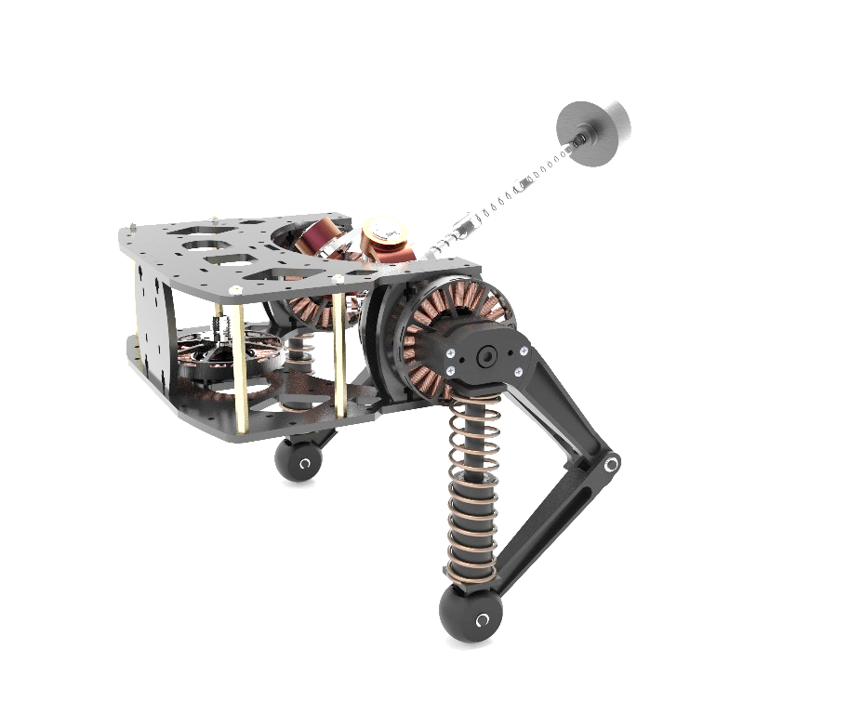
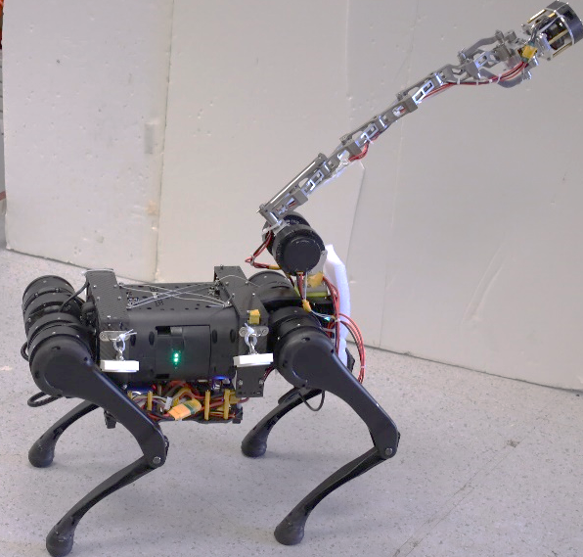
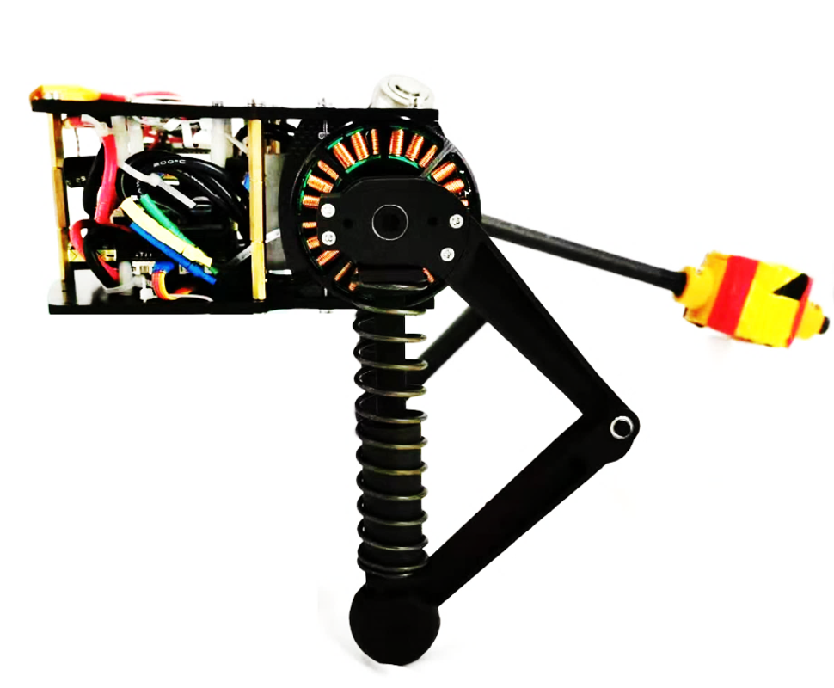

Slide 2
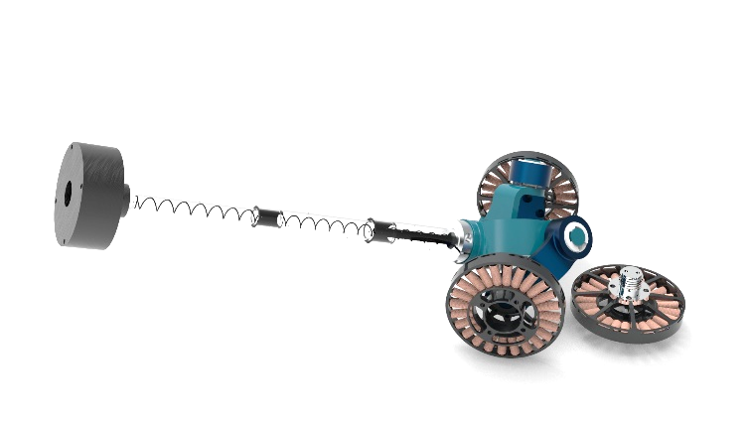
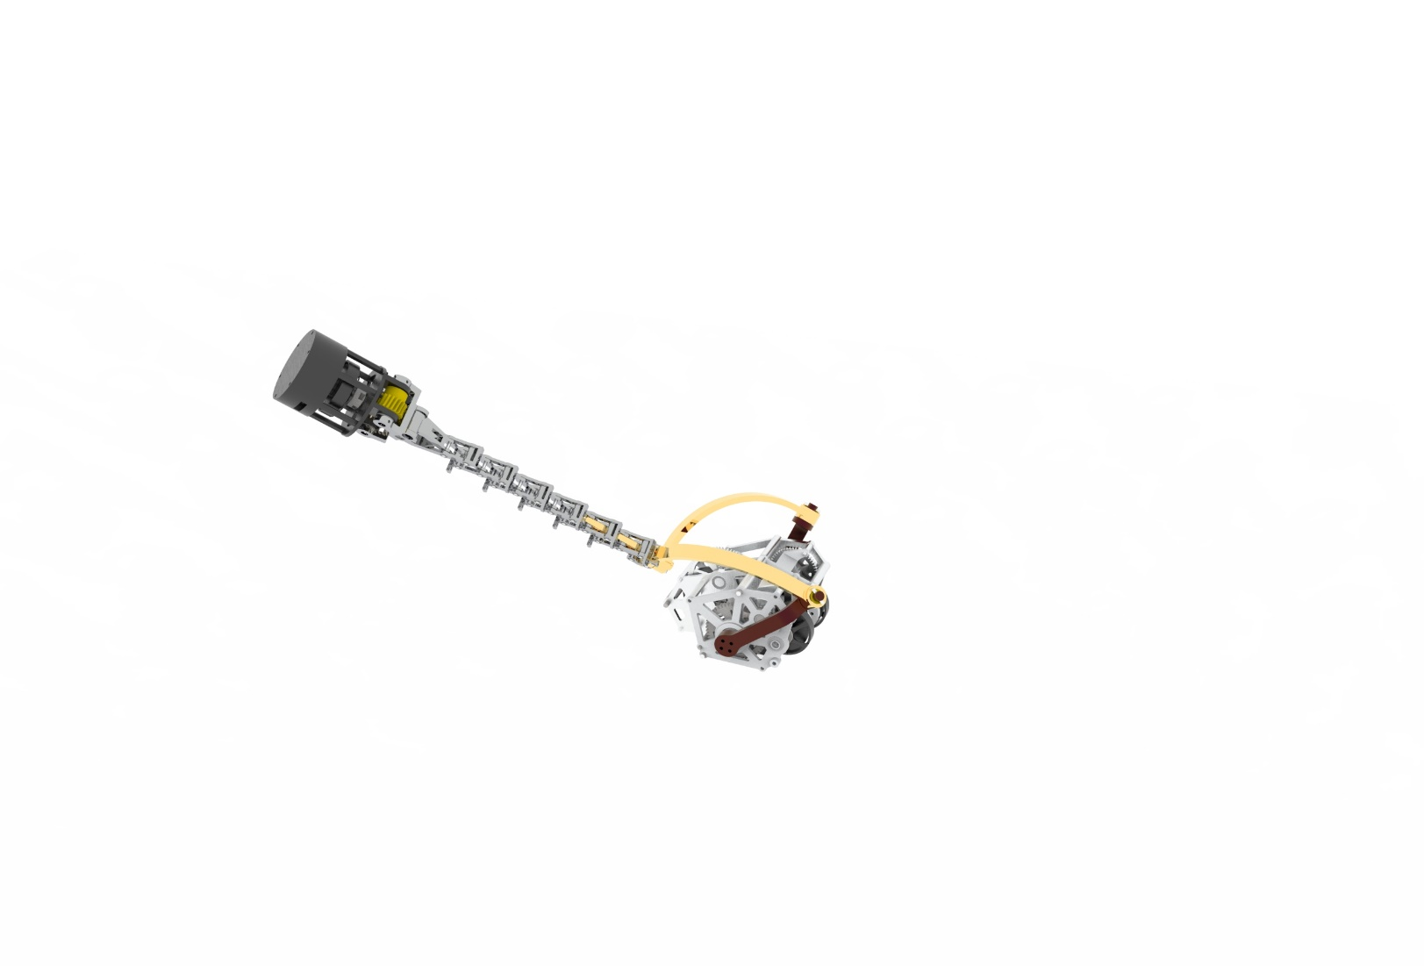
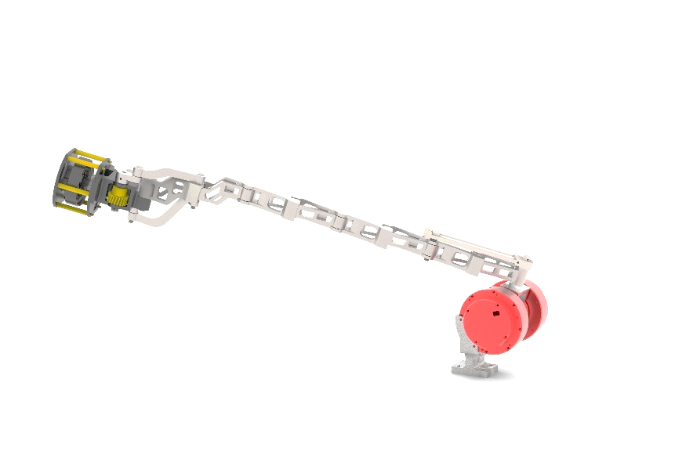
1

Slide 3
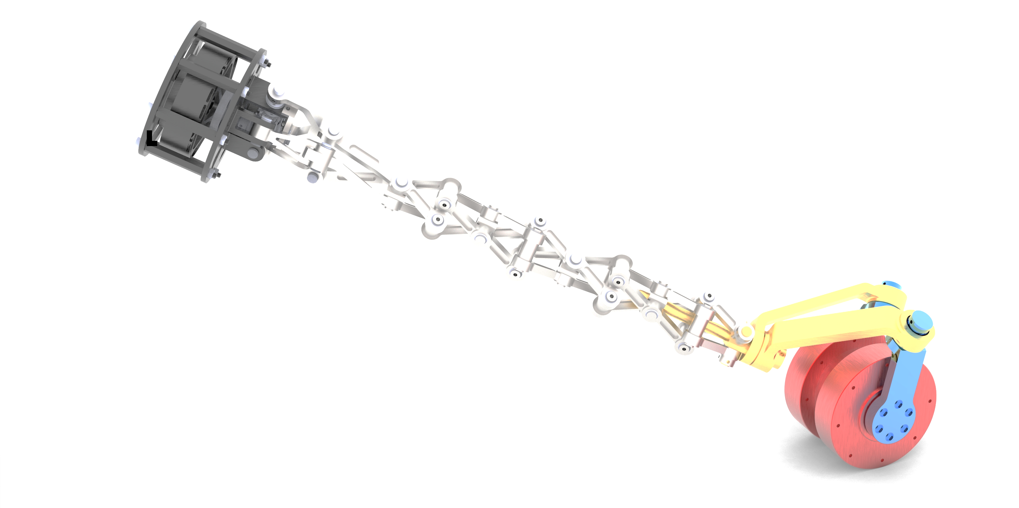
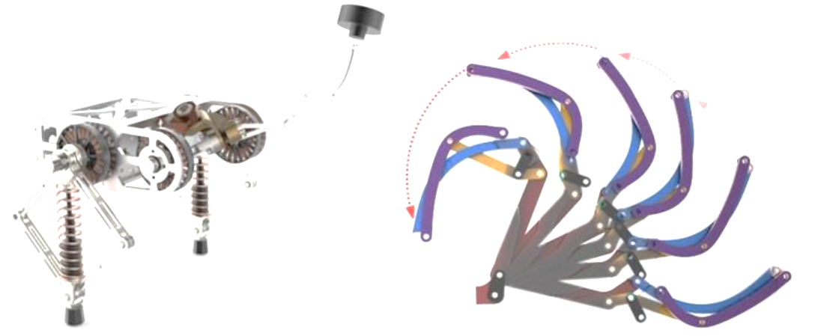

Slide 4
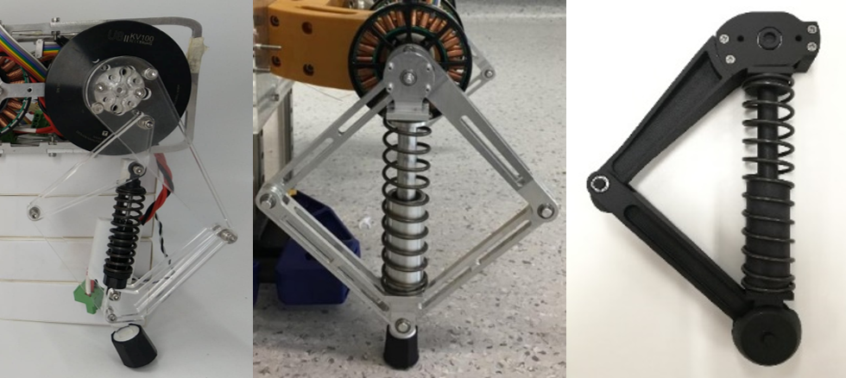
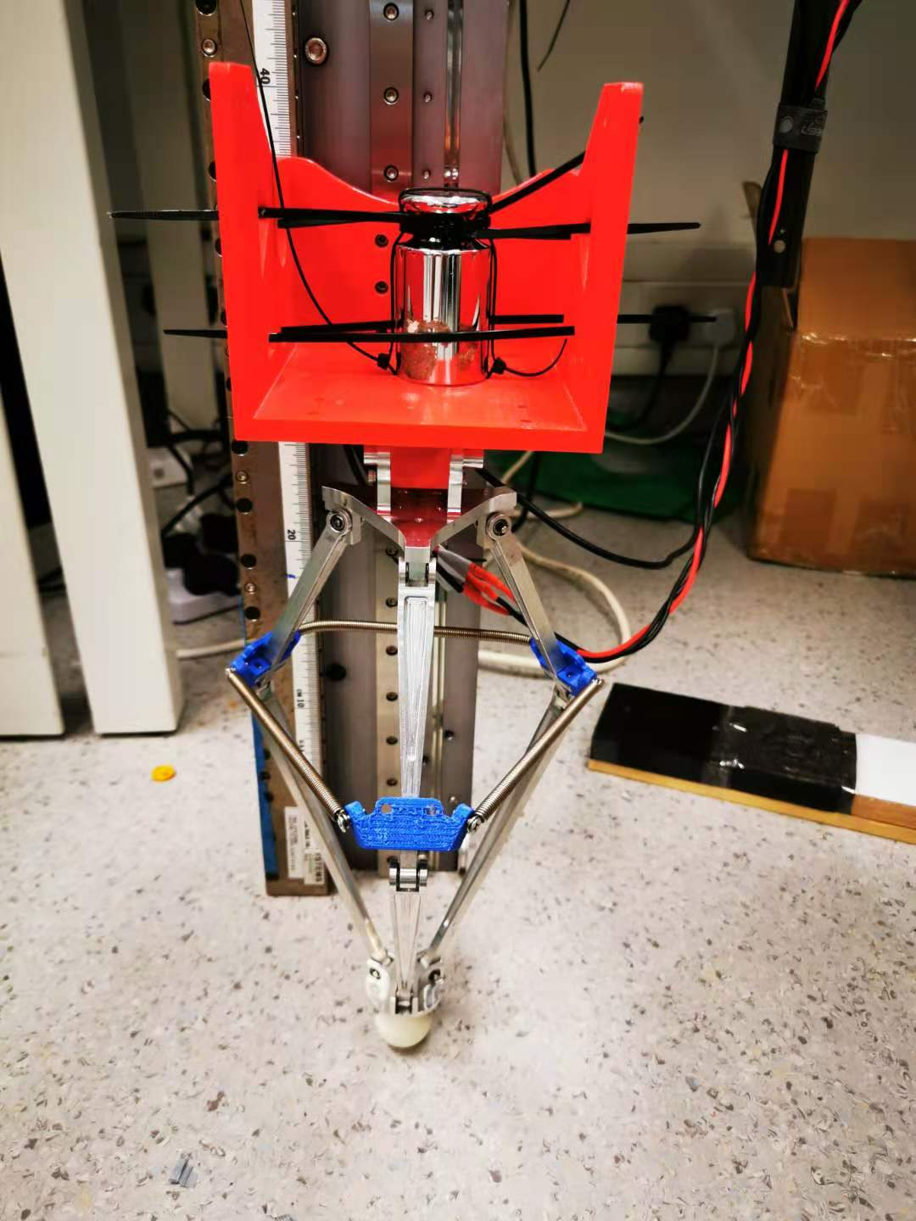
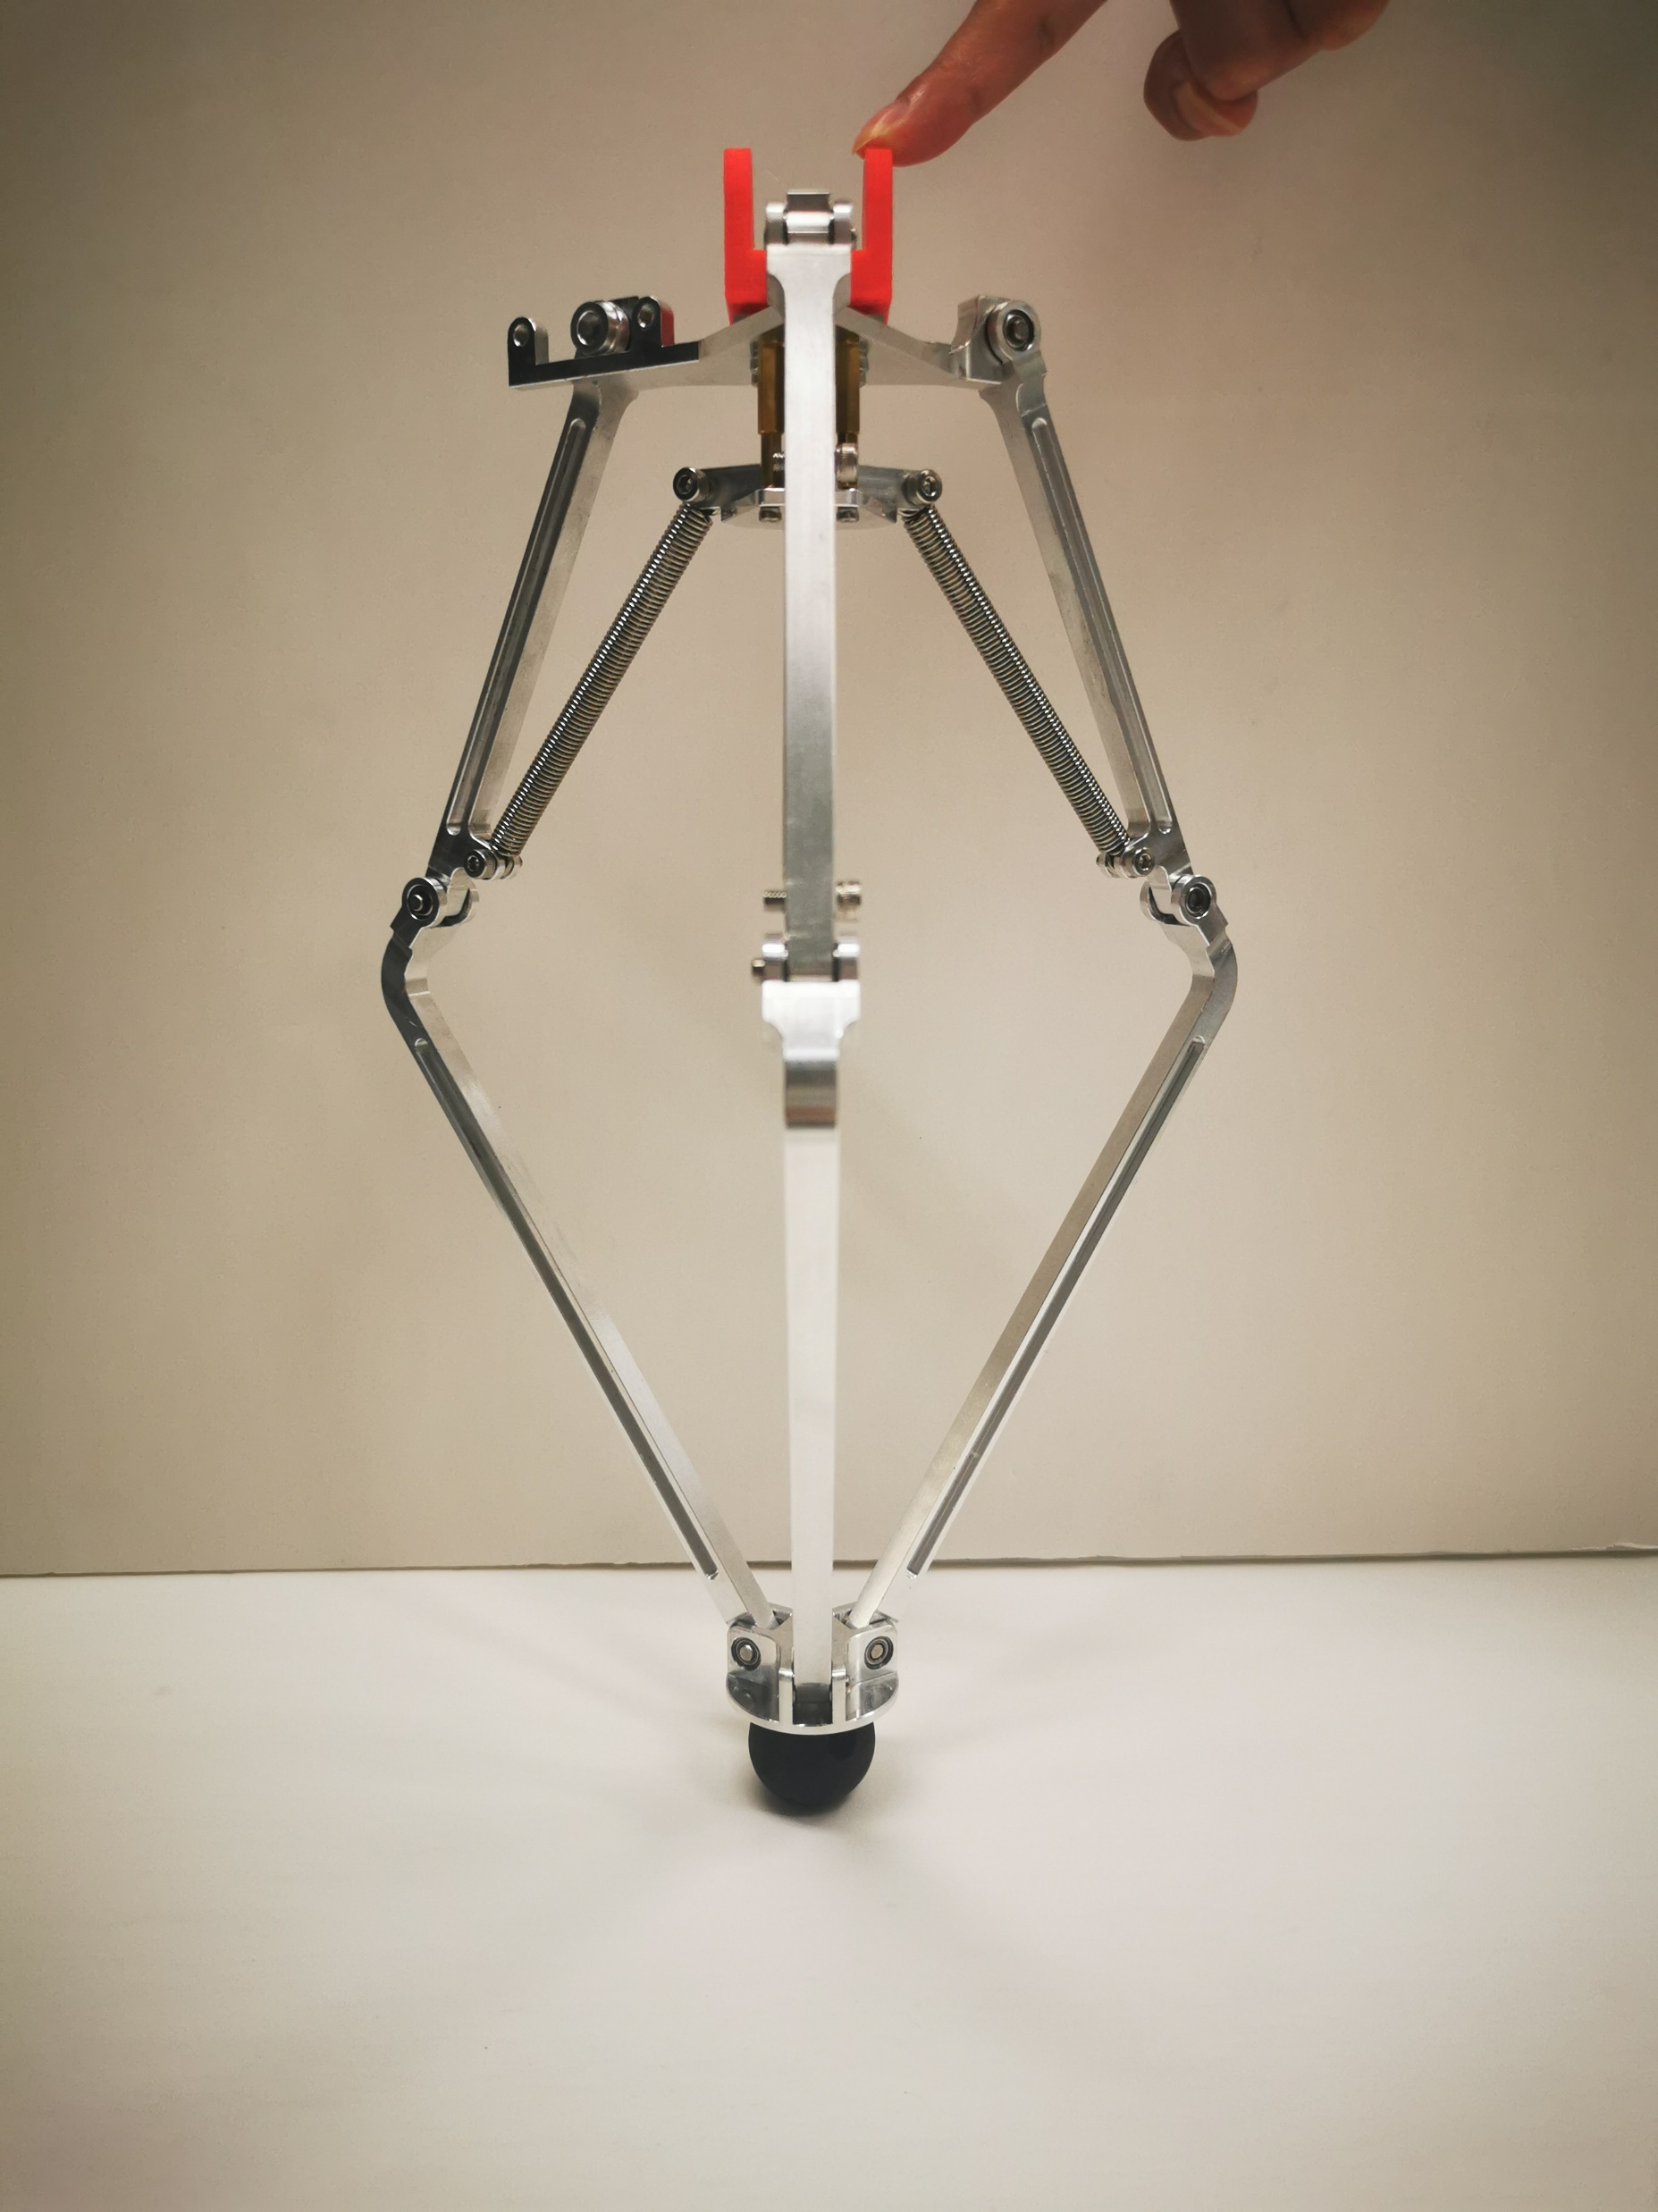
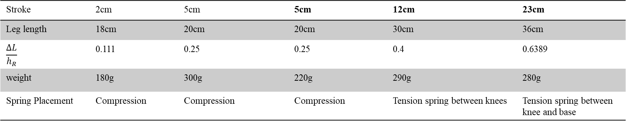
Stroke | 2cm | 5cm | 5cm | 12cm | 23cm
Leg length | 18cm | 20cm | 20cm | 30cm | 36cm
$$\frac{ΔL}{h_{R}}$$ | 0.111 | 0.25 | 0.25 | 0.4 | 0.6389
weight | 180g | 300g | 220g | 290g | 280g
Spring Placement | Compression | Compression | Compression | Tension spring between knees | Tension spring between knee and base

Slide 5
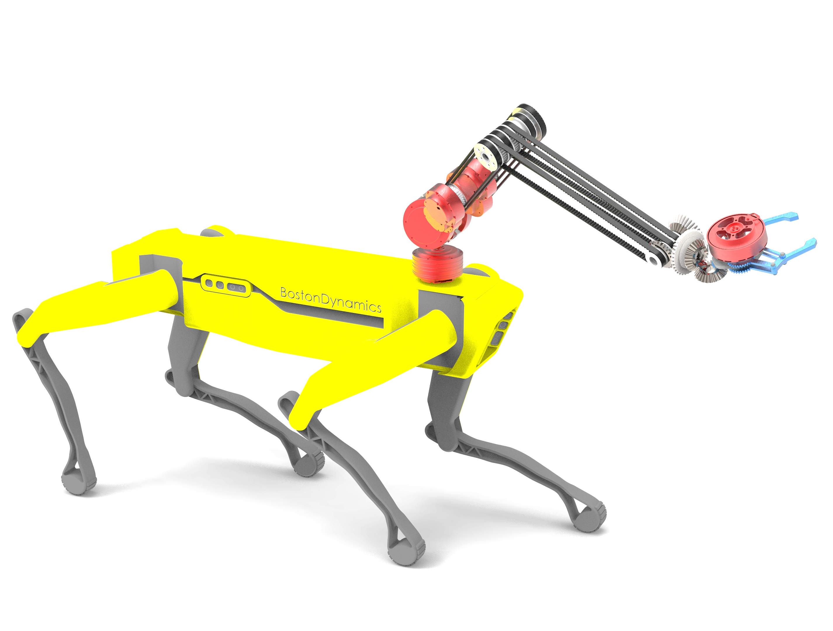

Slide 6
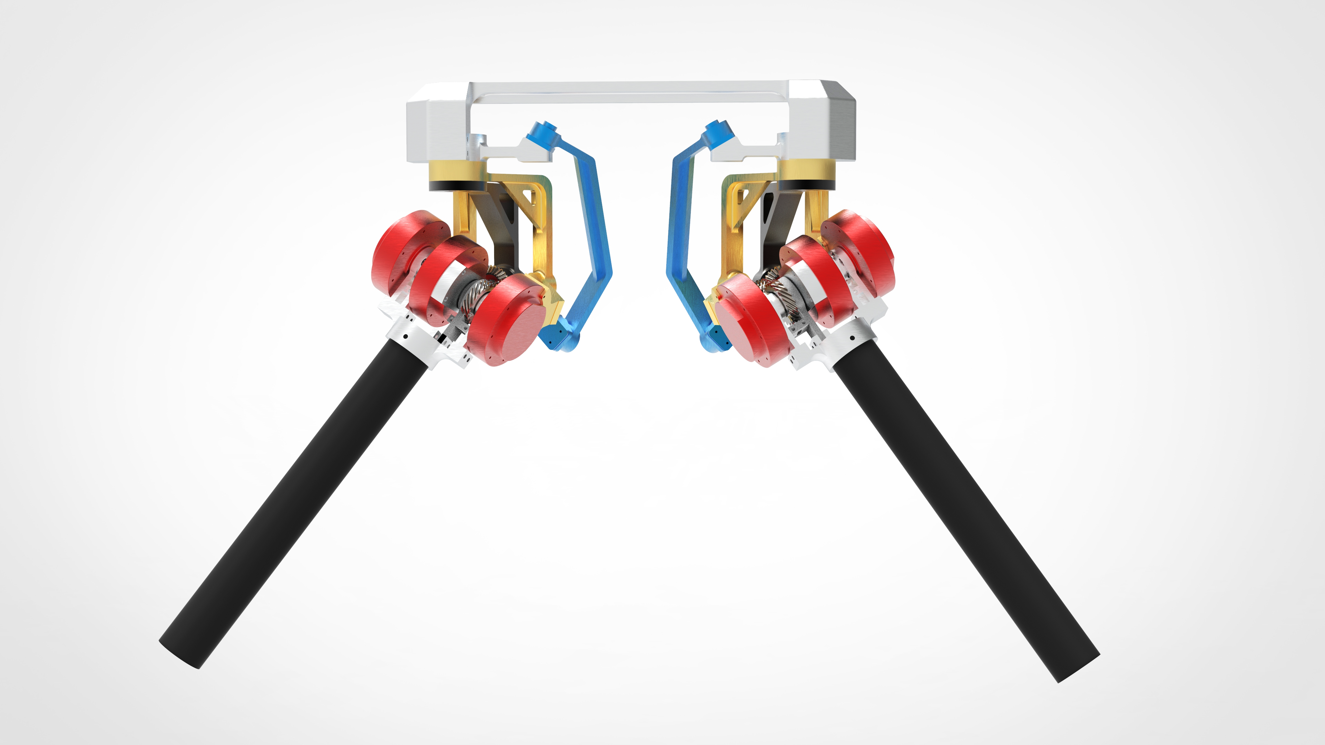
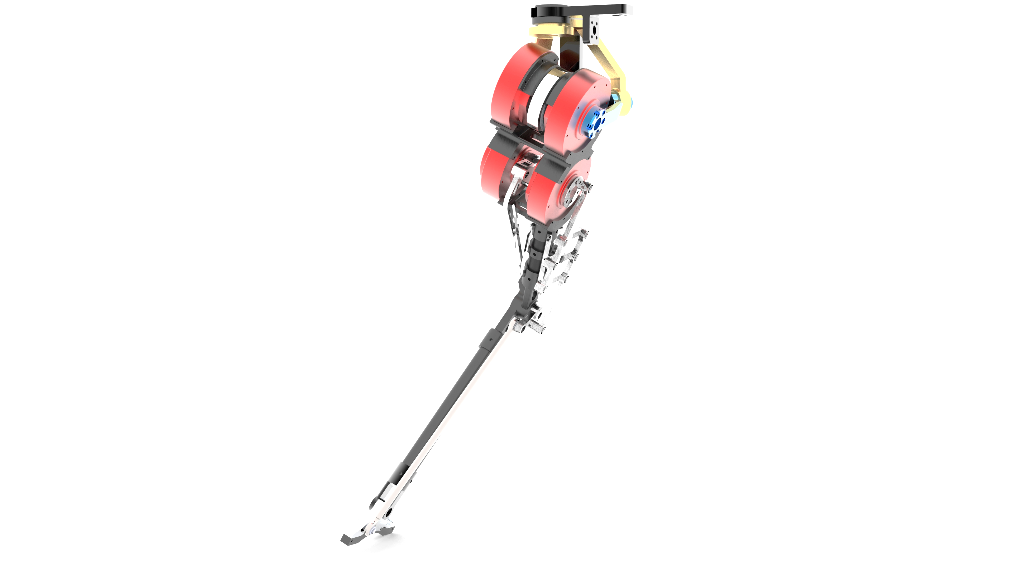
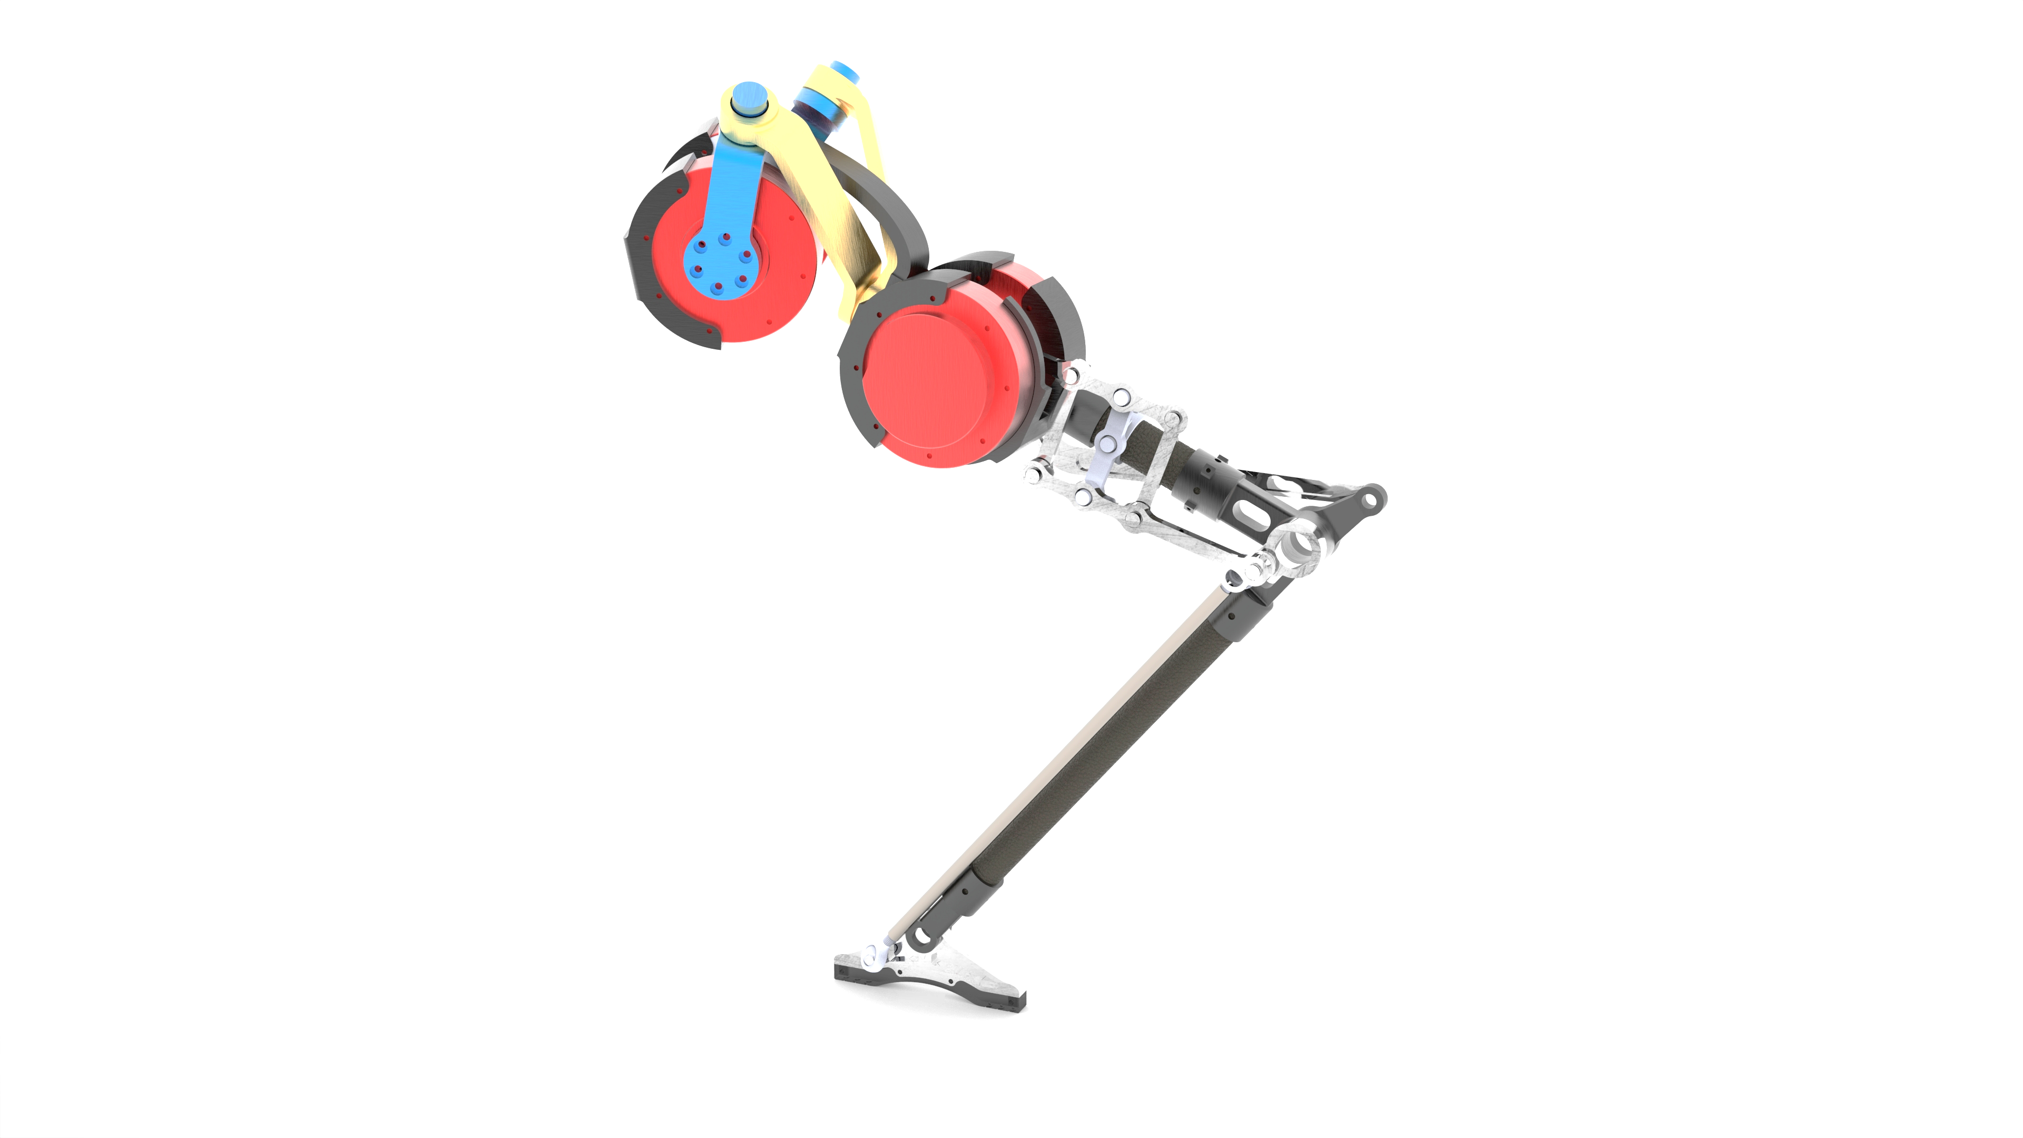
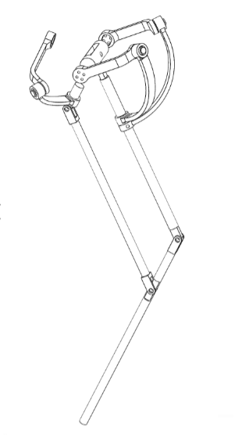

Slide 7
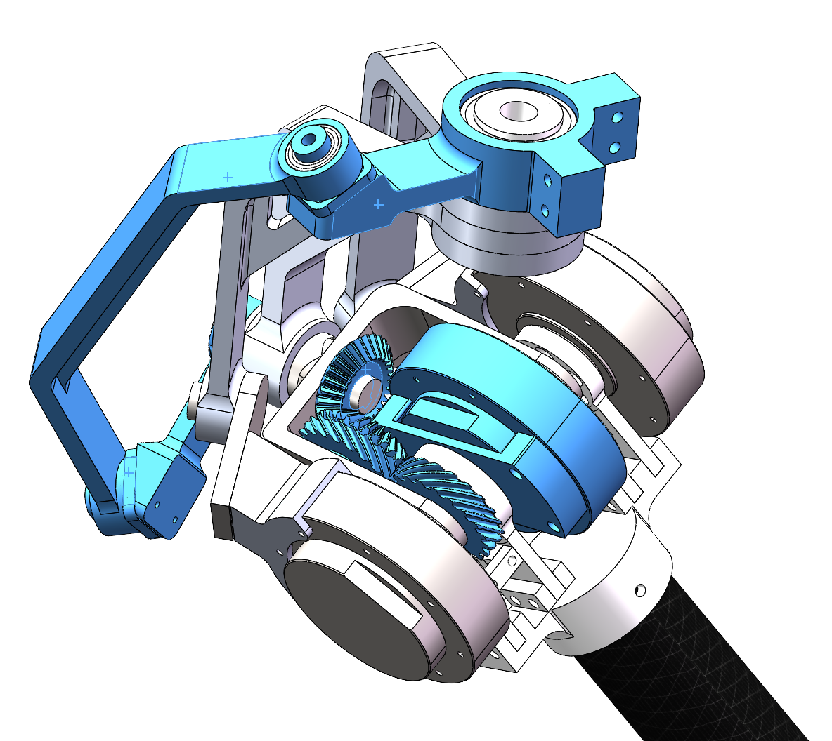
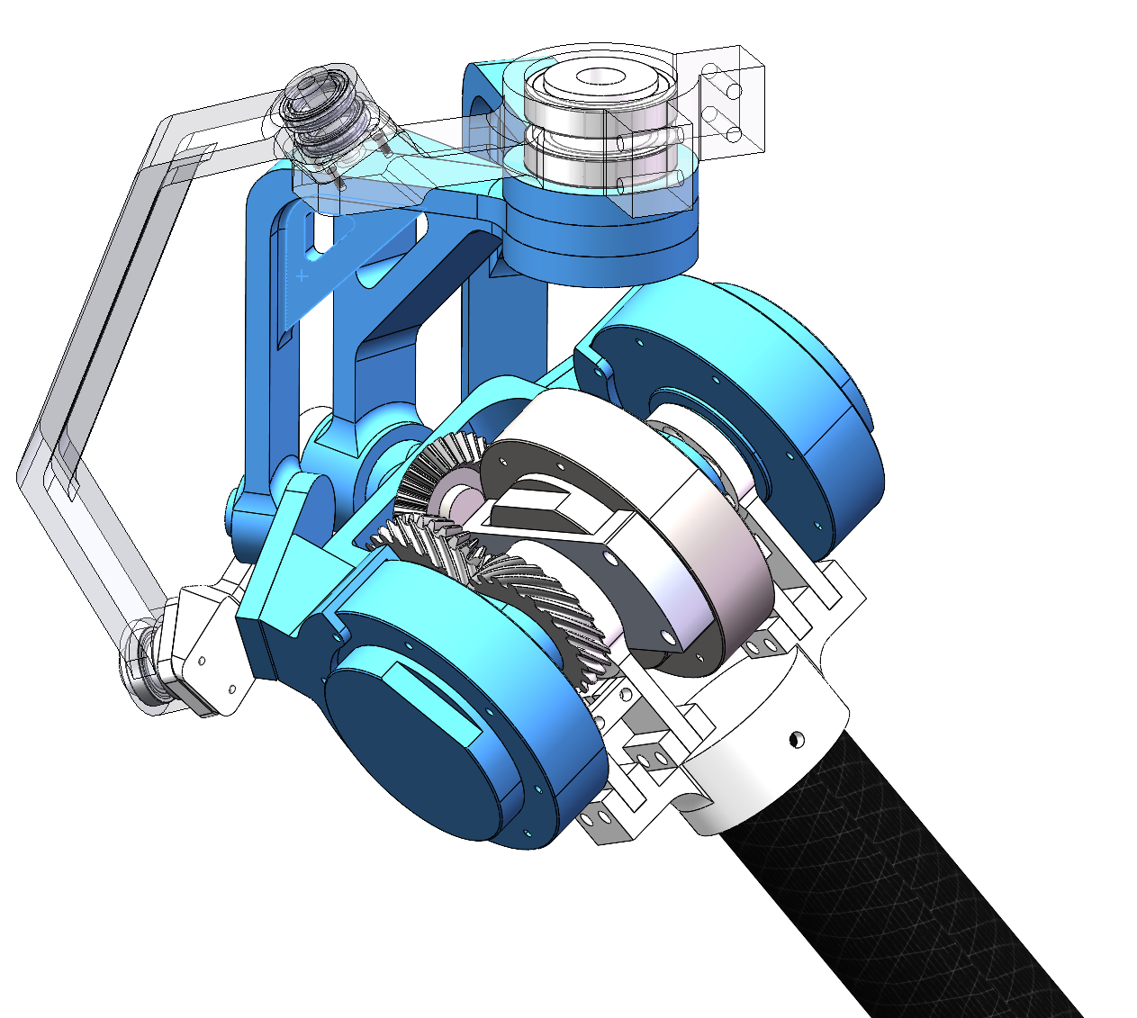
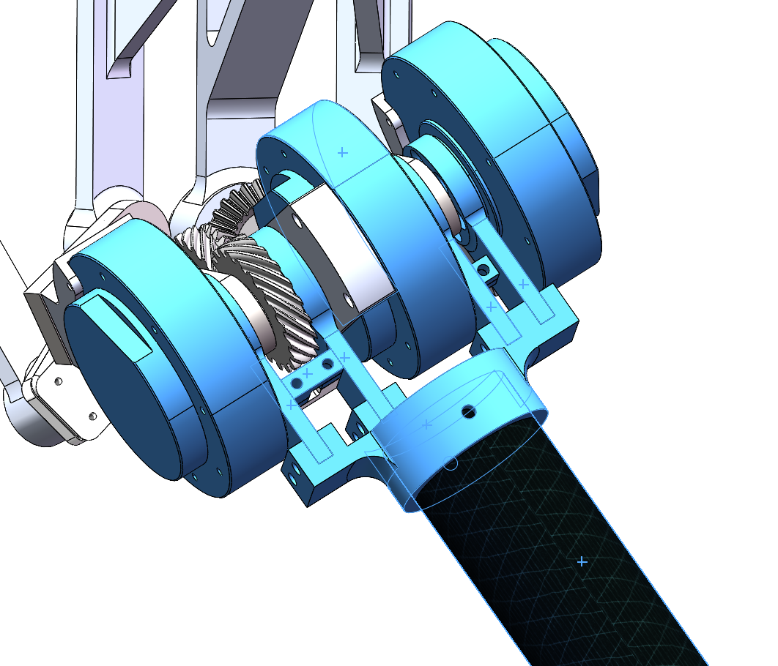
Coupled Double Differential Joint (CDD Joint)
First Differential Joint
Together Fixed Base
Abduction/Adduction DoF
2Motors: Based on SFB(spherical five bar linkage)
Yaw Motion DoF
1 Motor Control: Gear Transmission + 4-spherical-bar-linkage
Flexion/Extension DoF
3 Motors Swing together

Slide 8
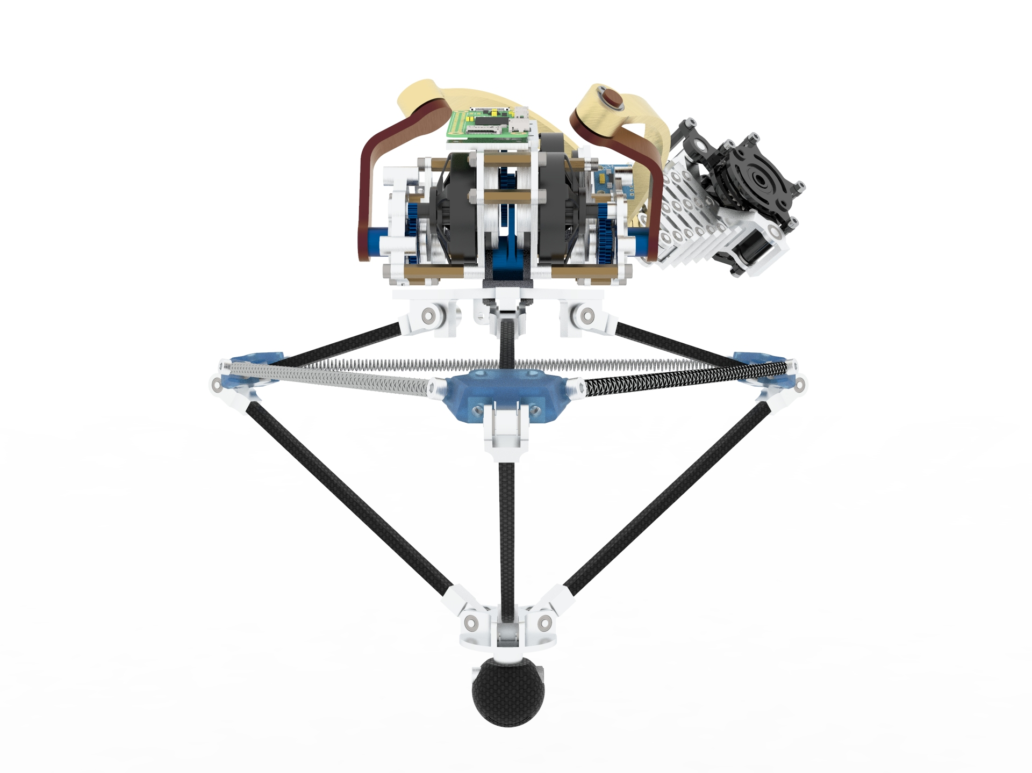

Slide 9
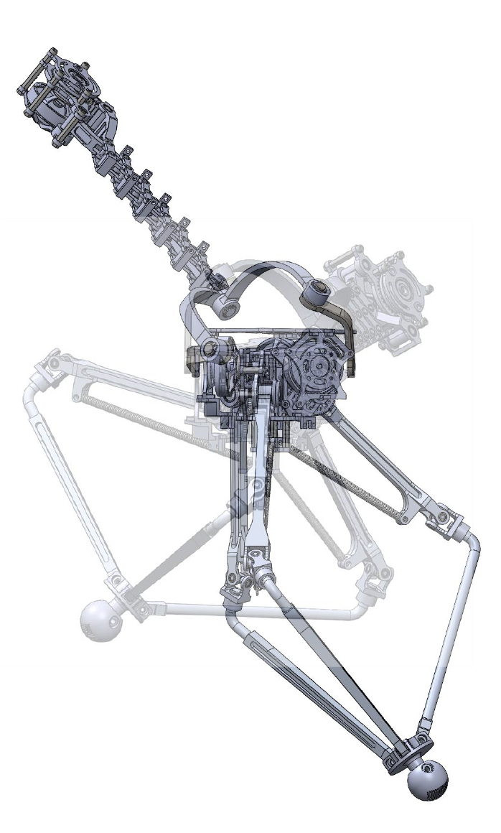
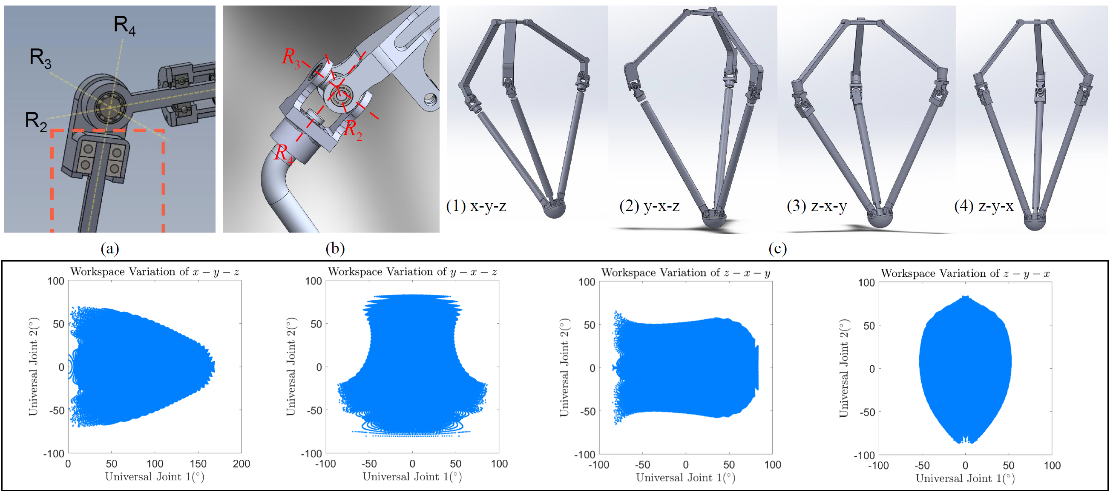
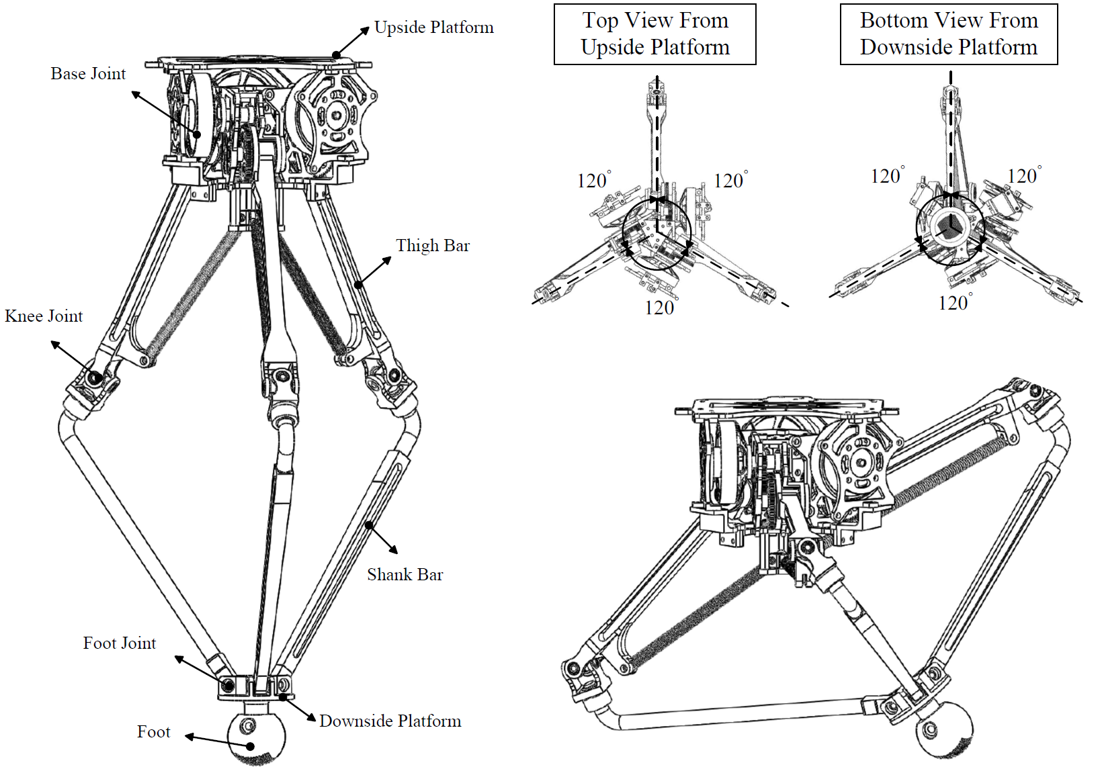
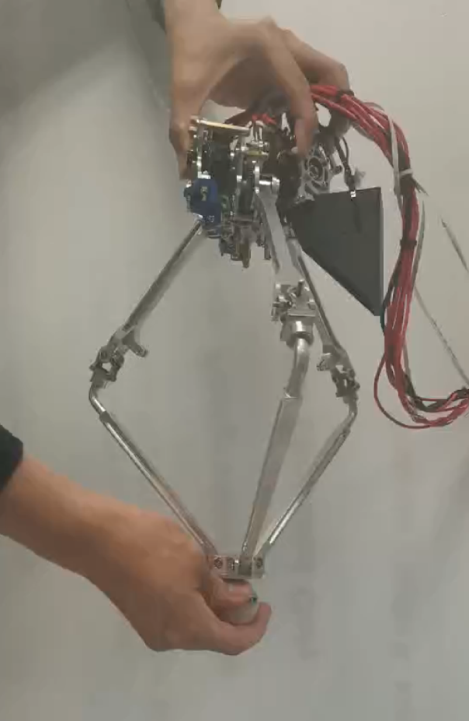
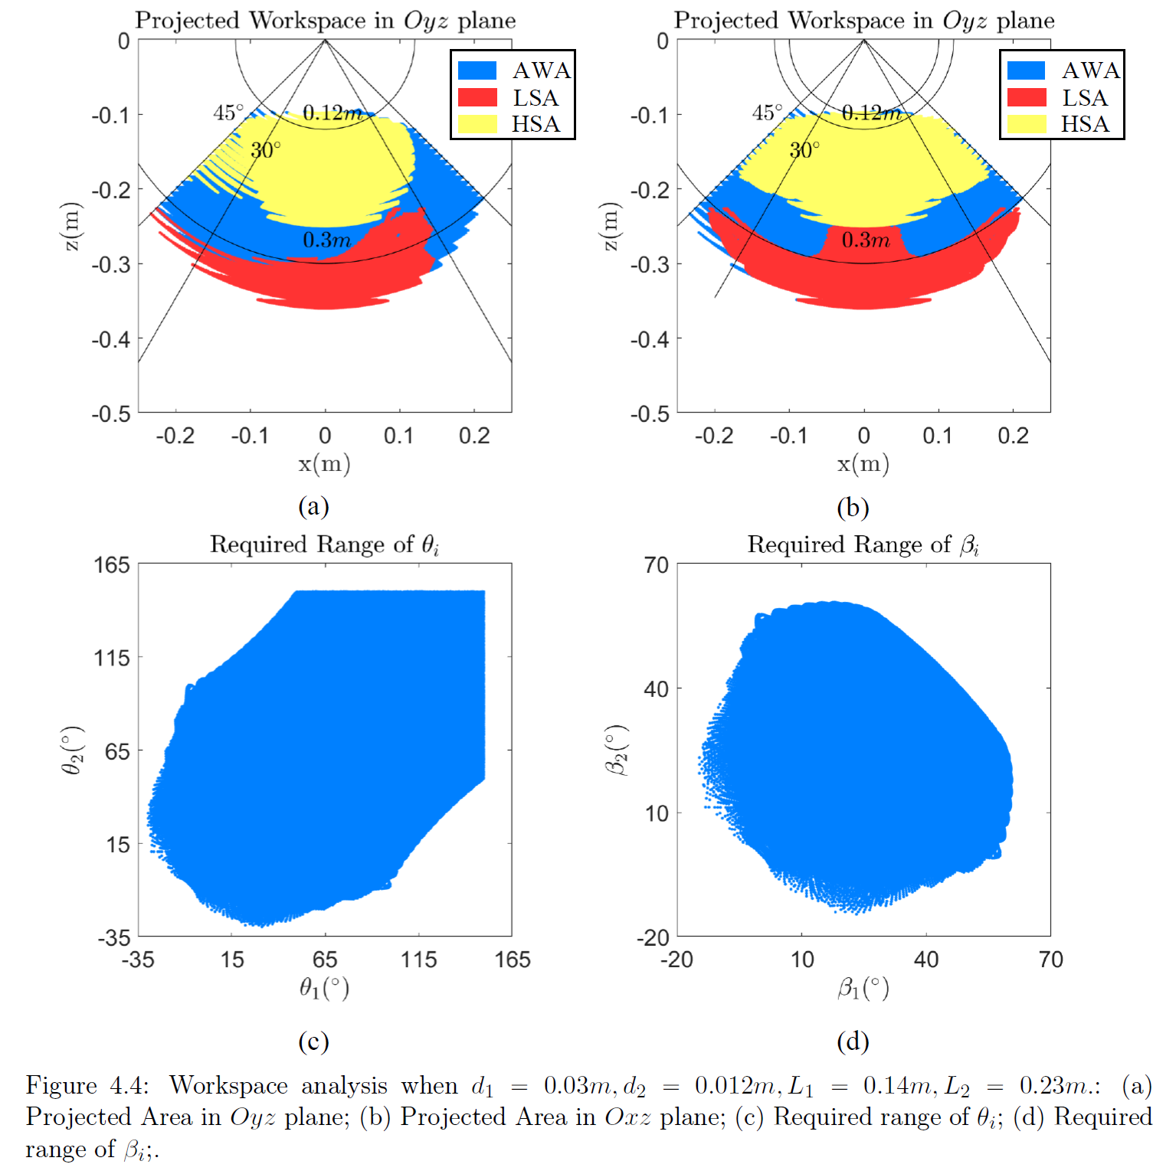
Design Overview
Joint Optimization
Leg Design
Spring Integration Analysis
Initial Prototype

Slide 10
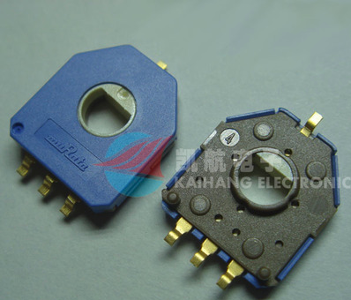
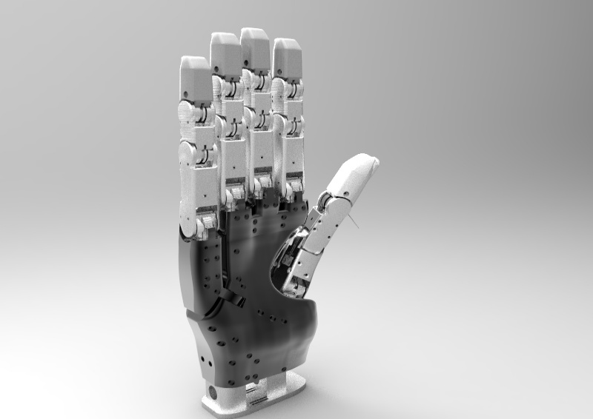
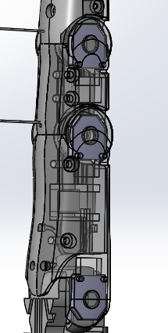
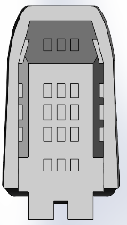
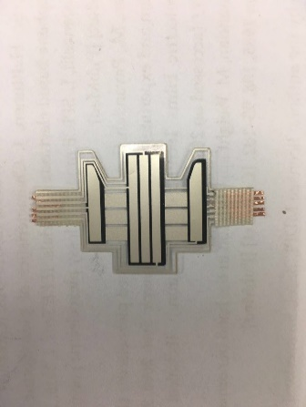
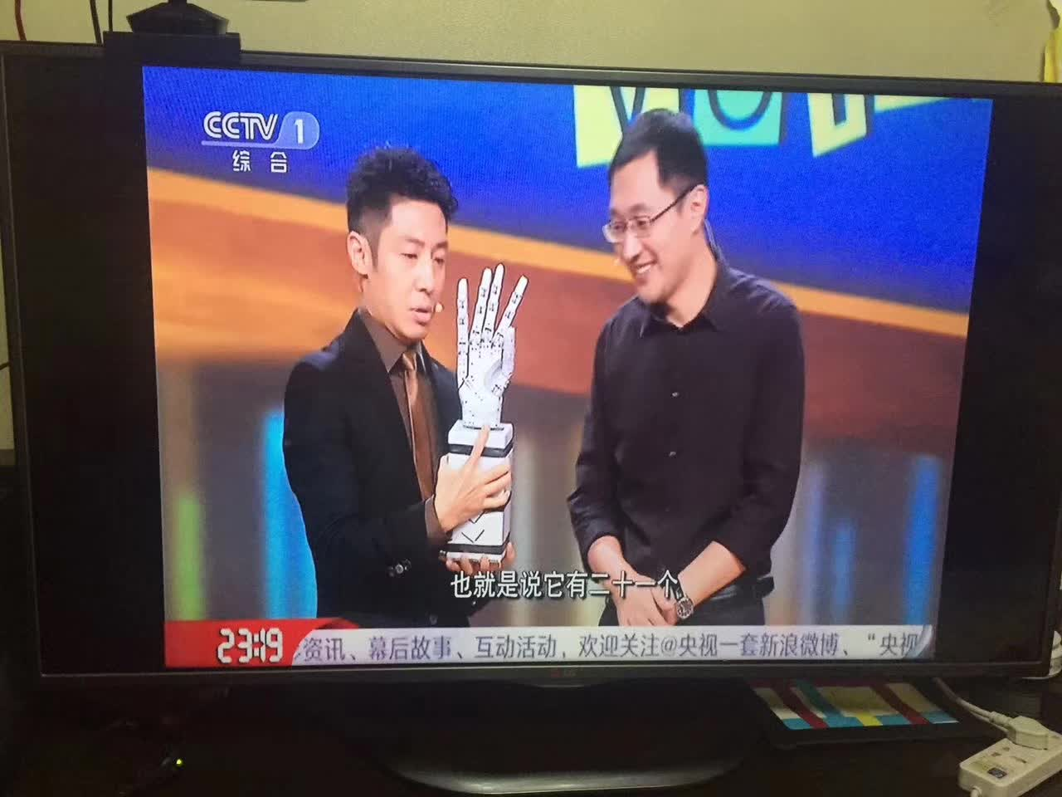
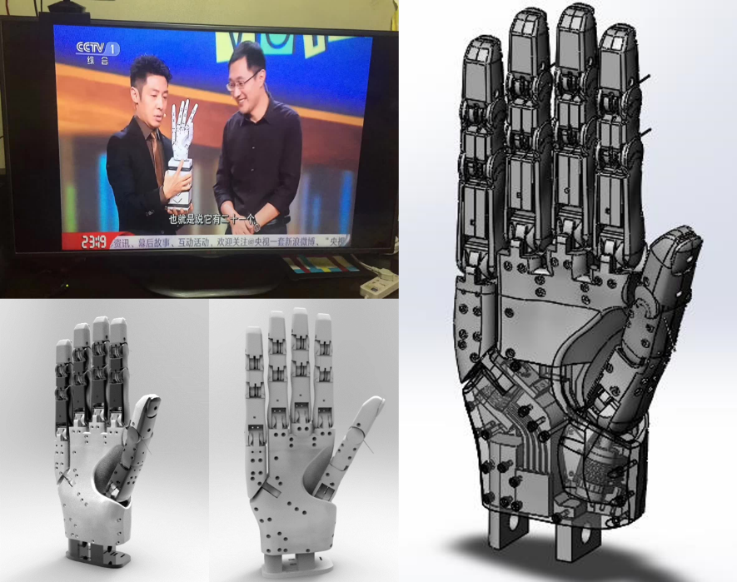
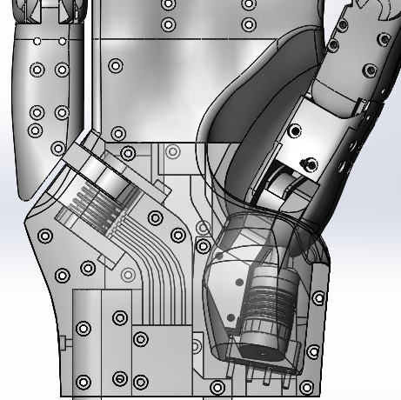
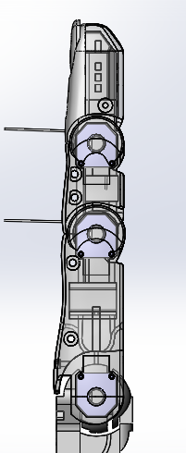
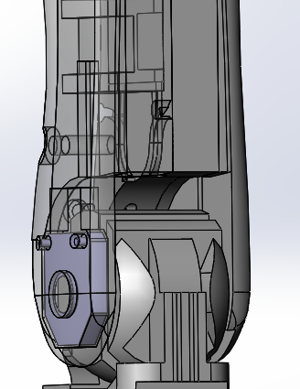
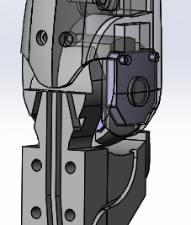
Design Overview
Sensor Integration
Prototype
Design Details

Slide 11
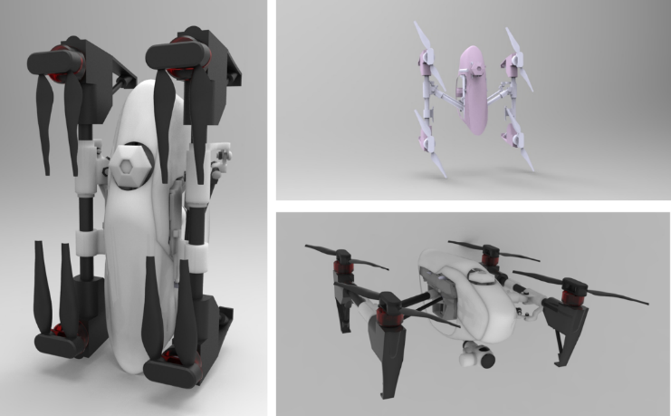

Slide 12
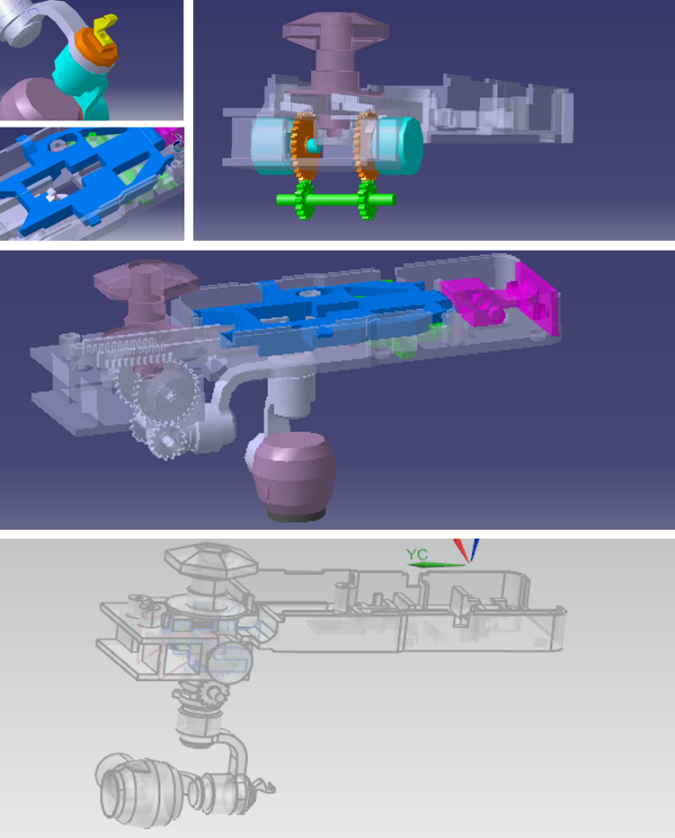
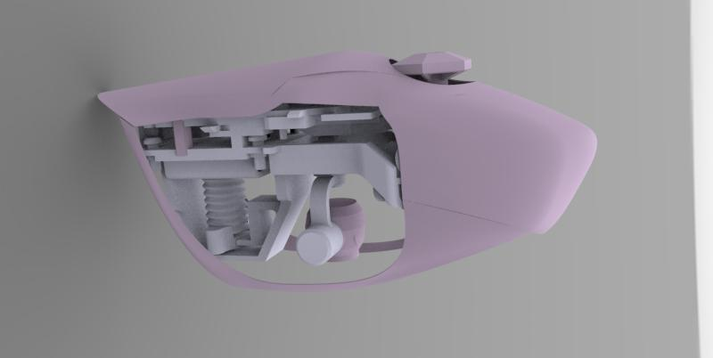
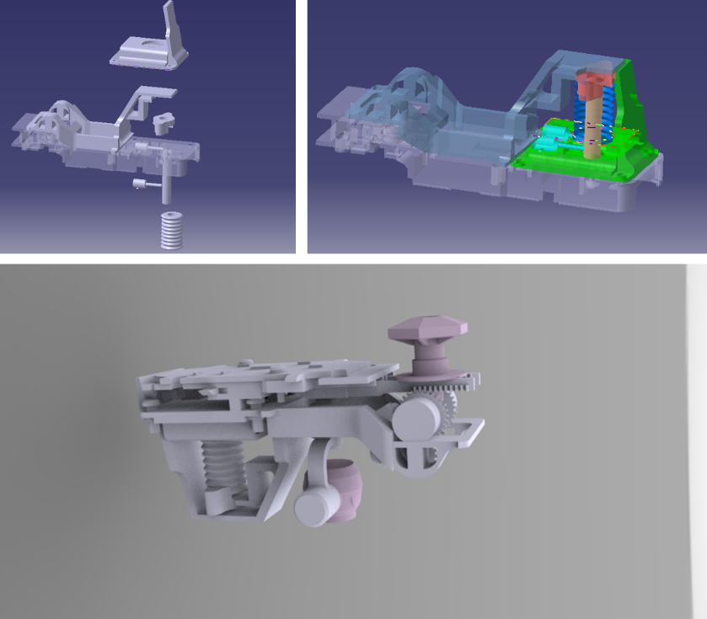
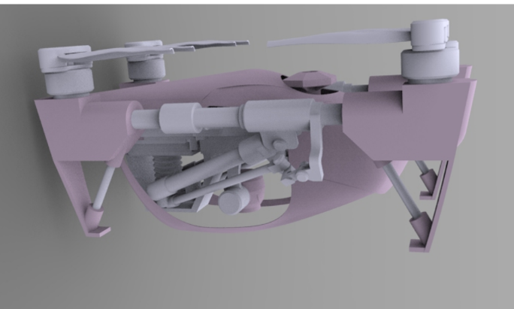
Design Overview
Design Details

Slide 13
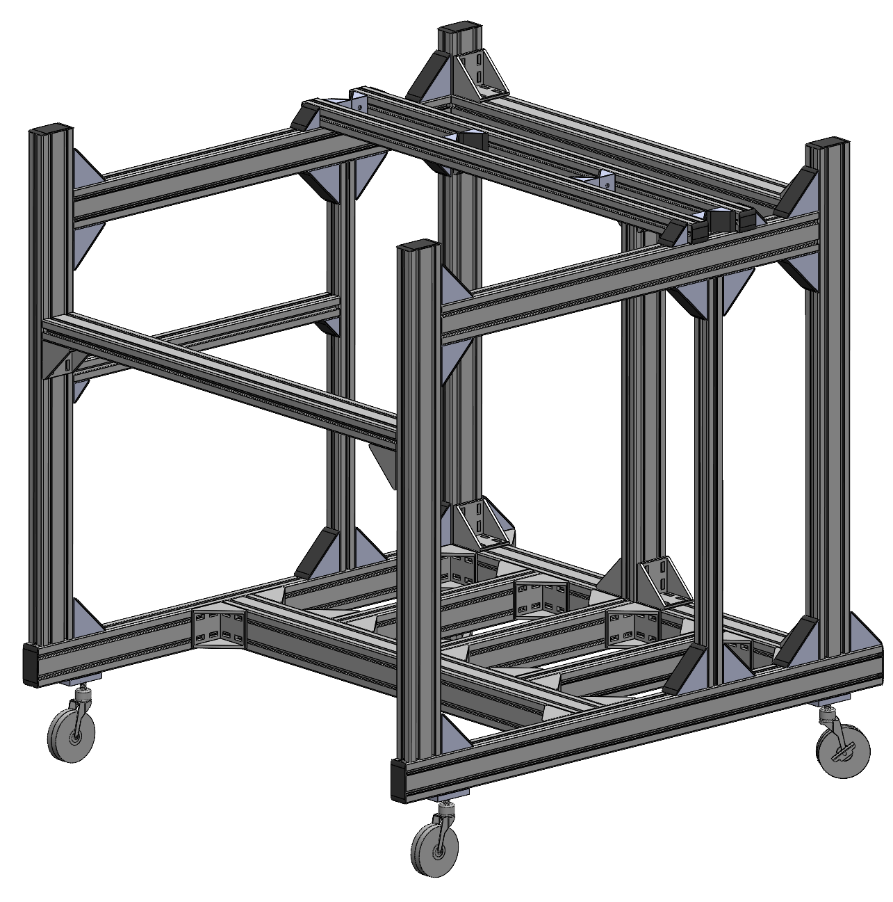
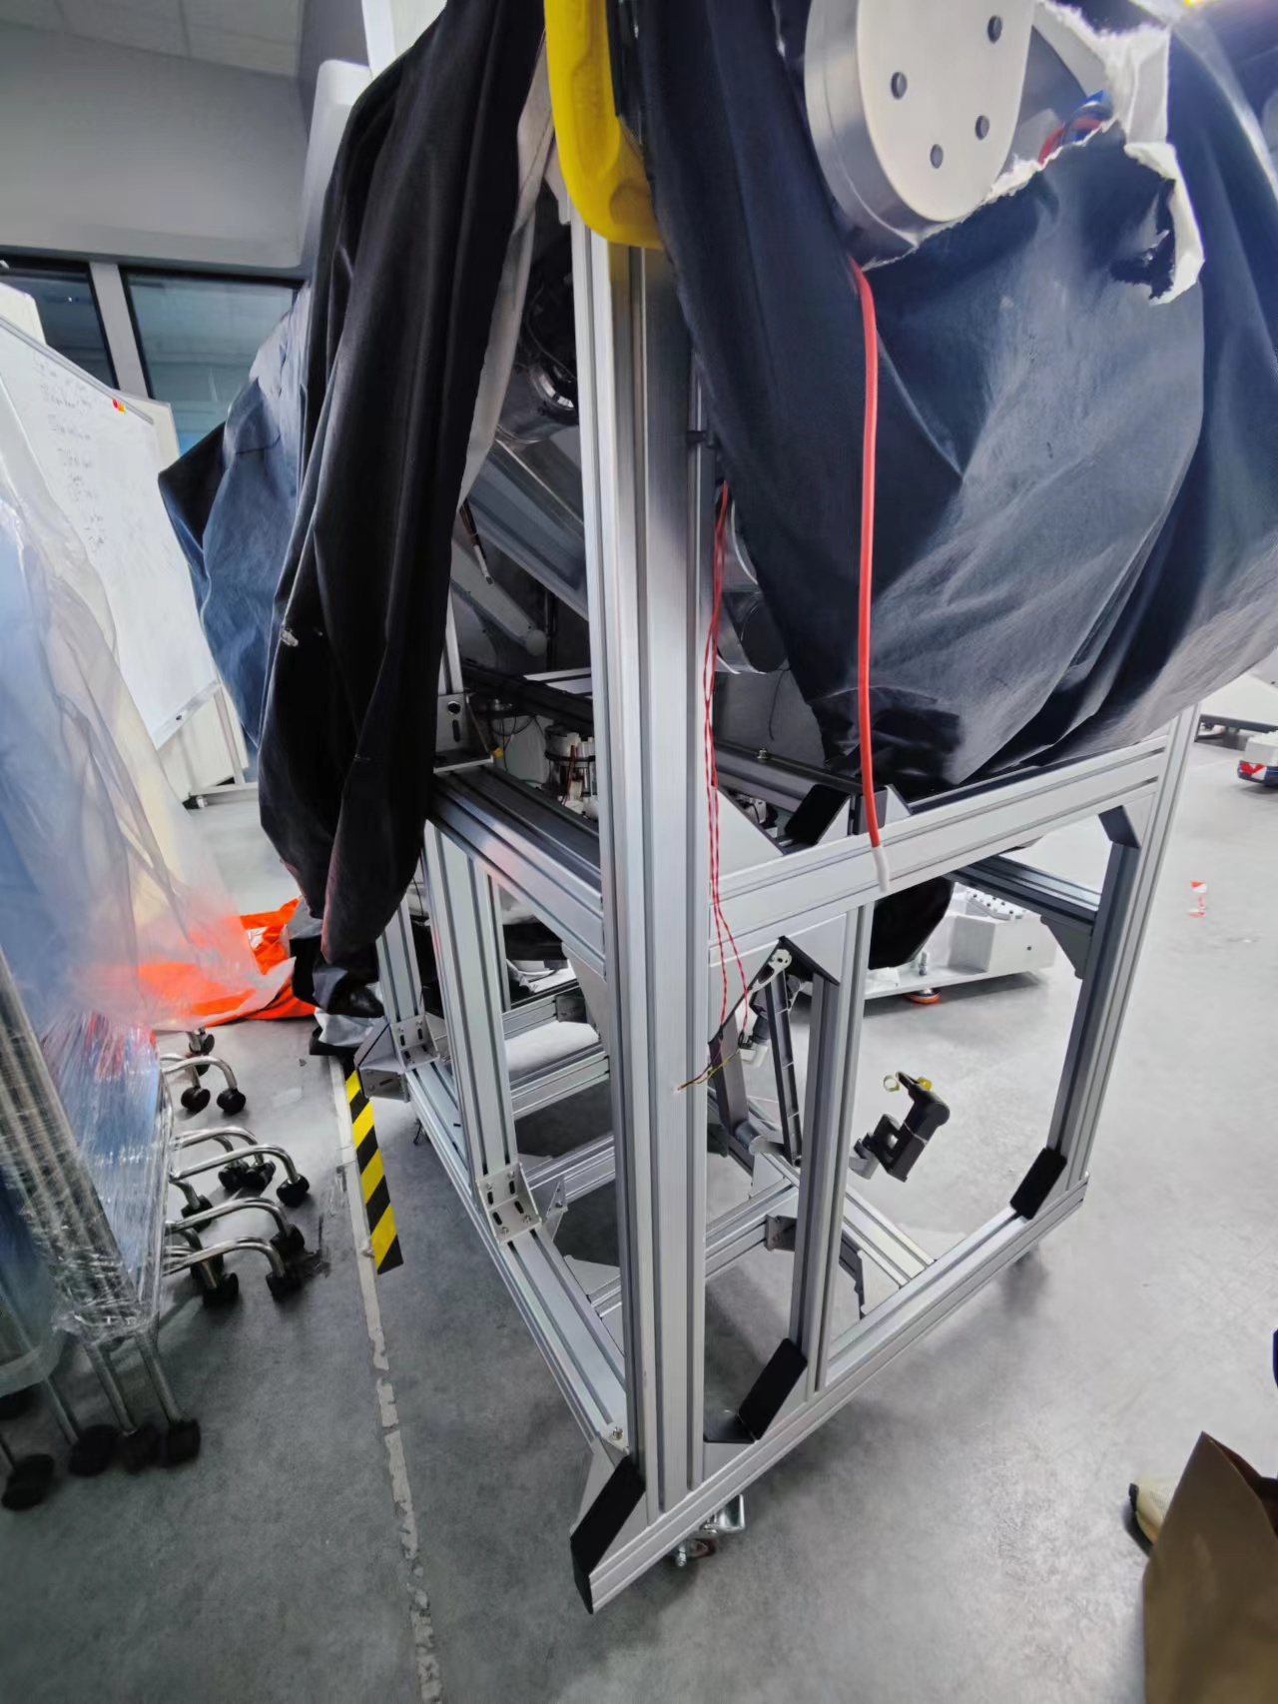
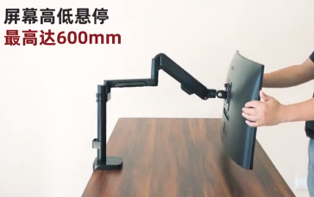
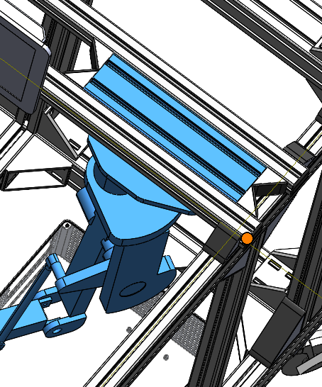
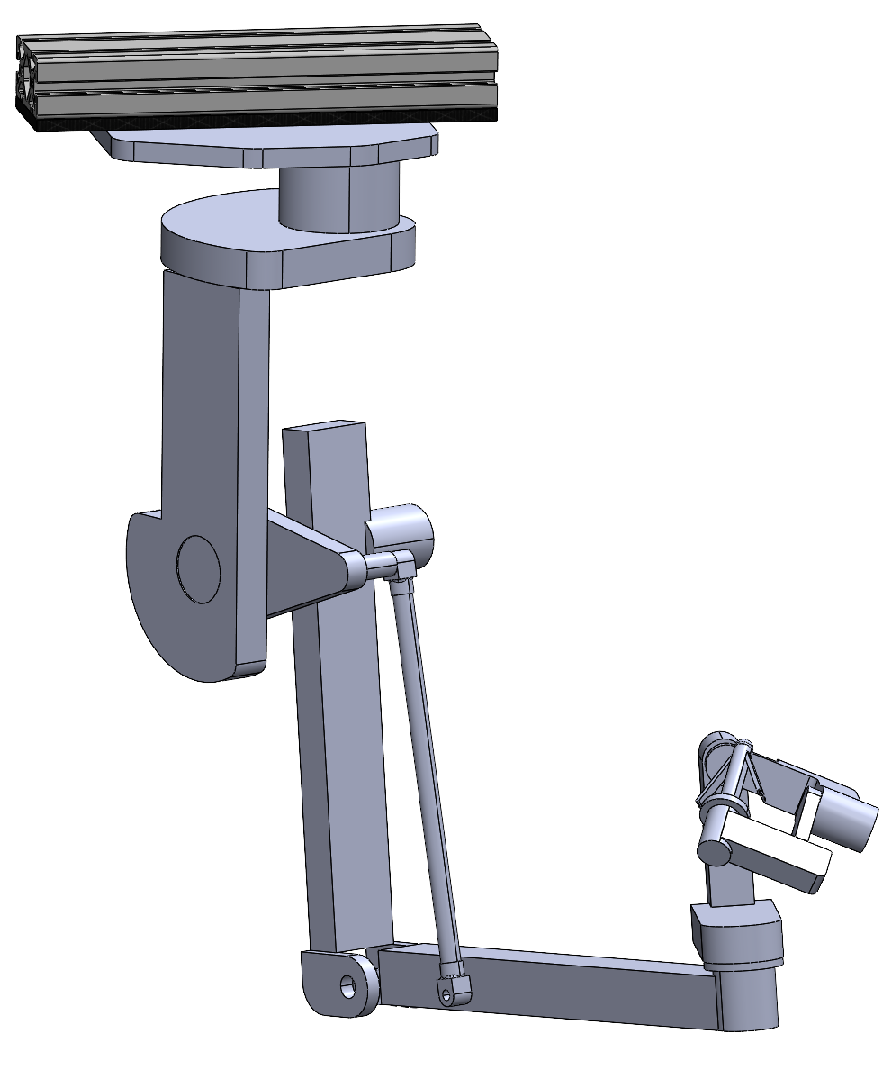
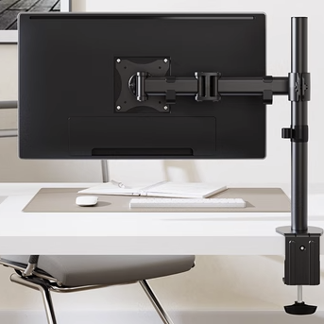
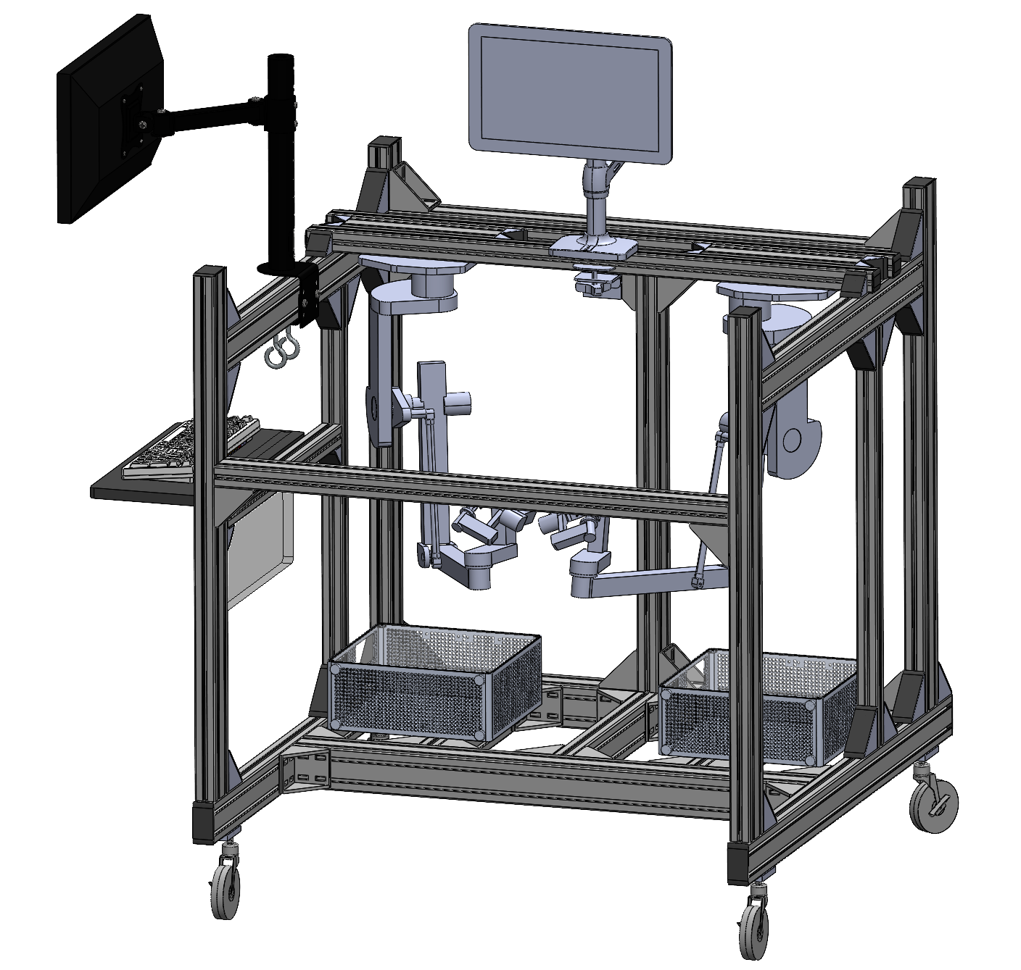



Main Body for Transporting
Connect with the framing structure for easy mounting.
Monitor Arm 1
Master Arm
Monitor Arm 2
医用万向推车轮子
(first choice)
铝型材专用福马脚轮 (backup choice, for undertaking larger forces and being more stable)
Keyboard Placer
Overview
Wheel

Slide 14

Design Overview
Prototype

Slide 15


Slide 16





Design Overview
Design Details
Tail Usages:
Balance
Adjust the walking directions
Telescopic tail can help multiple adjustment
Background
Target Motions:
Pipe or even Rope walking
Plain ground walking
Waling between 2 pipes ,walking over a hole, walking inner the pipes.

Slide 17



A
B

Slide 18






Design Overview
Design Details
A
B
Background

Slide 19


